Slide 1
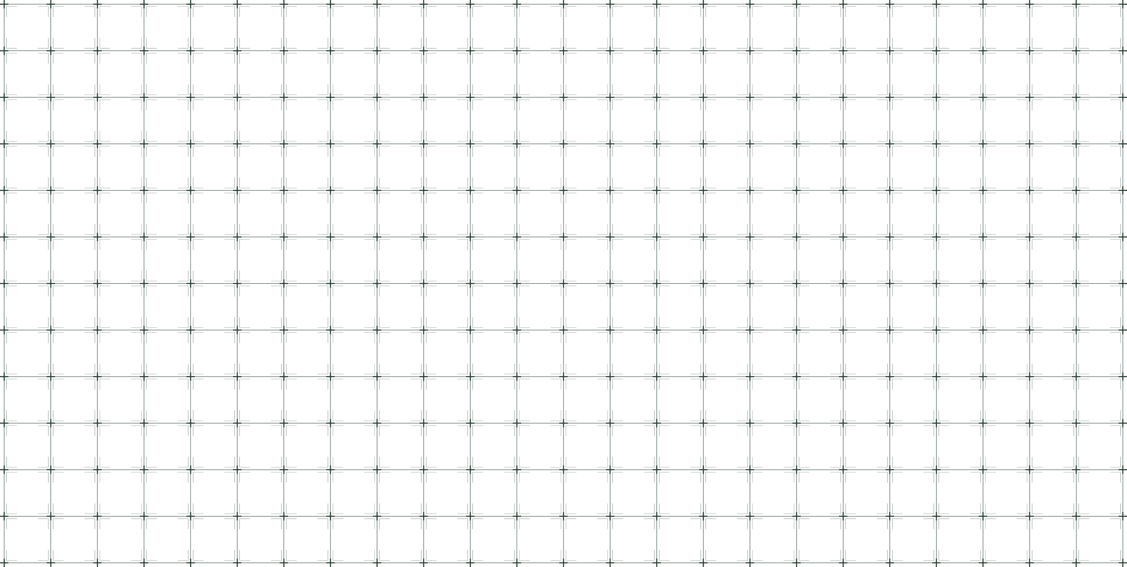

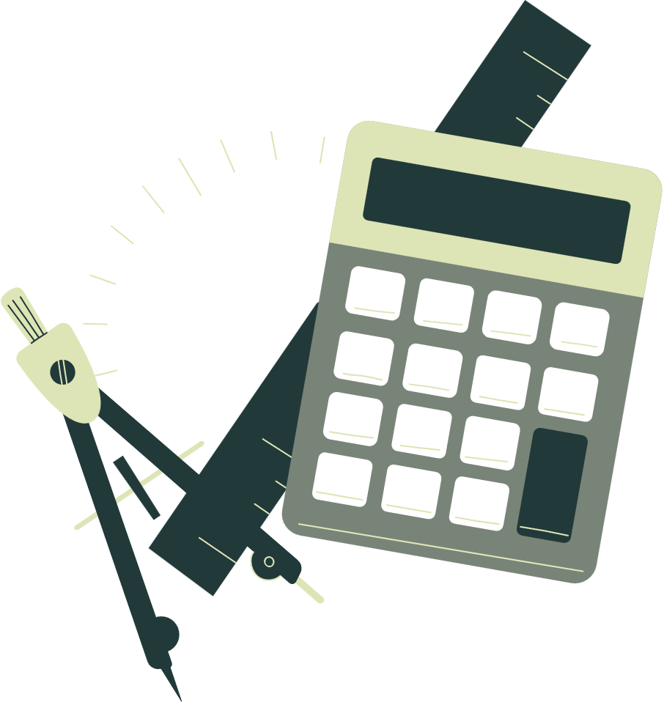


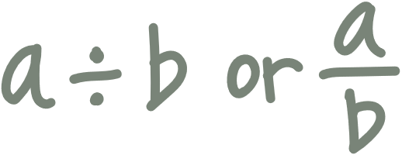
Welcome to our
MATHEMATICS
Class
Prepared by: Mr. Fajardo

Slide 2
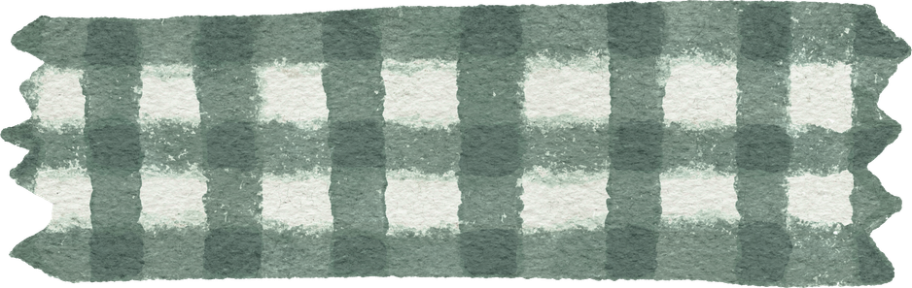
Learning Objectives
Demonstrate the process of completing the square to transform a quadratic expression into a perfect square trinomial.
Solve quadratic equations by completing the square.

Slide 3
Exploration activity

Slide 4
Exploration activity
Complete the Square

Slide 5
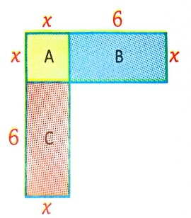
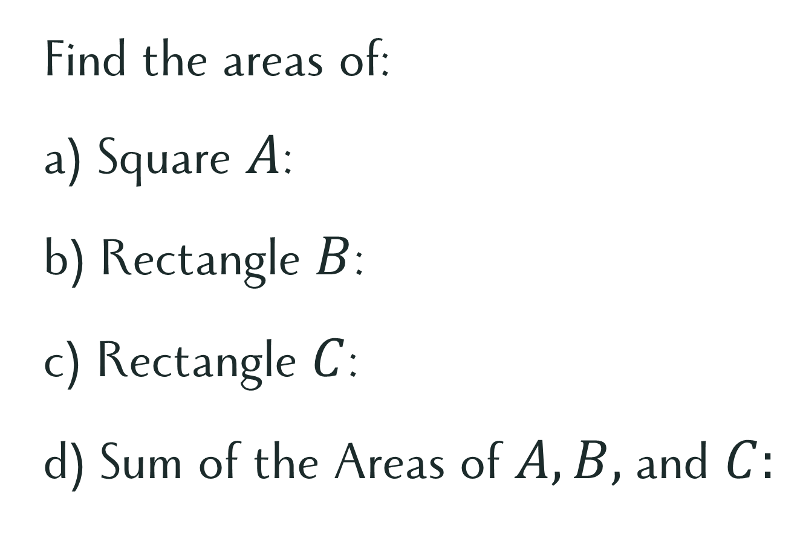
Complete the Square
Consider the figure:
Find the areas of:
a) Square $A$:
b) Rectangle $B$:
c) Rectangle $C$:
d) Sum of the Areas of $A, B,$and $C:$

Slide 6
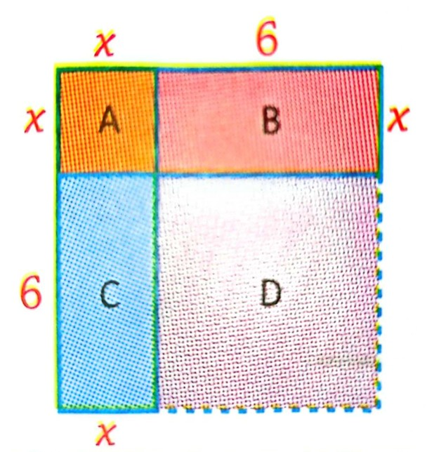
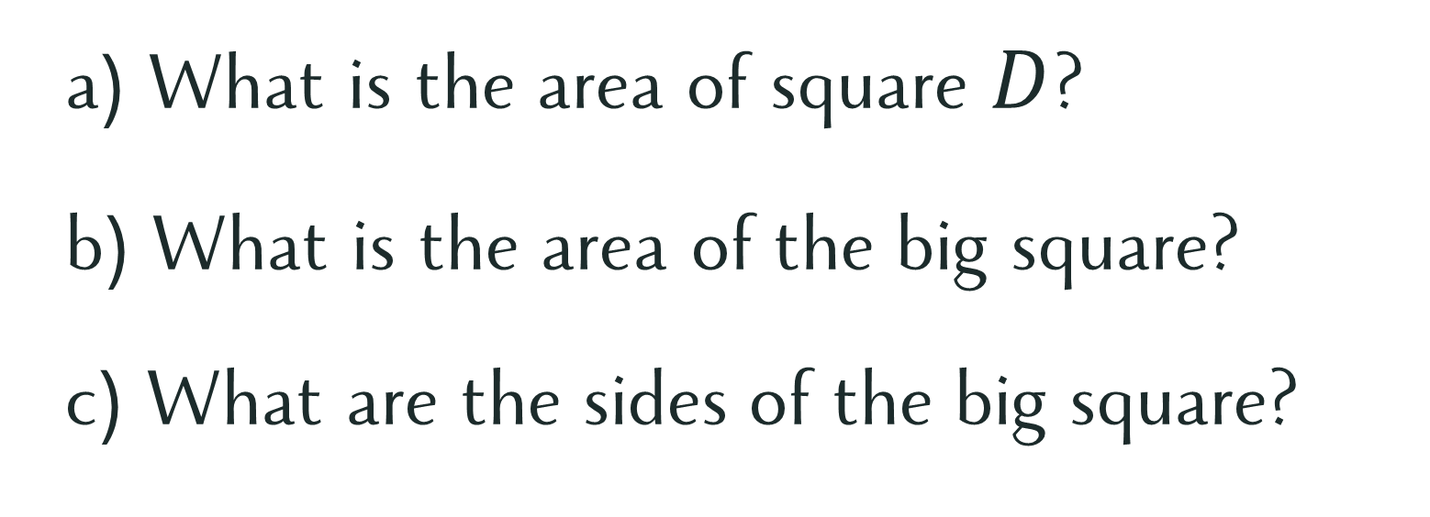
Complete the Square
Complete the big square by adding a figure.
a) What is the area of square $D$?
b) What is the area of the big square?
c) What are the sides of the big square?

Slide 7

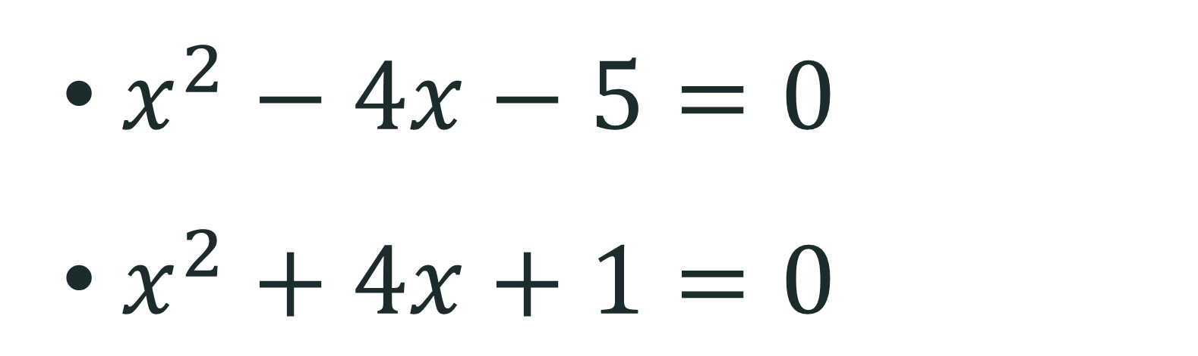
Let’s Try This!
Solve the quadratic equations by factoring.
$x^{2}−4x−5=0$
$x^{2}+4x+1=0$

Slide 8
Let’s Try This!
Solve the quadratic equations by factoring.
$x^{2}−4x−5=0$
$x^{2}+4x+1=0$
How to solve a quadratic equation that is not factorable?

Slide 9
Quadratic equations
Solving
by Completing the Square

Slide 10
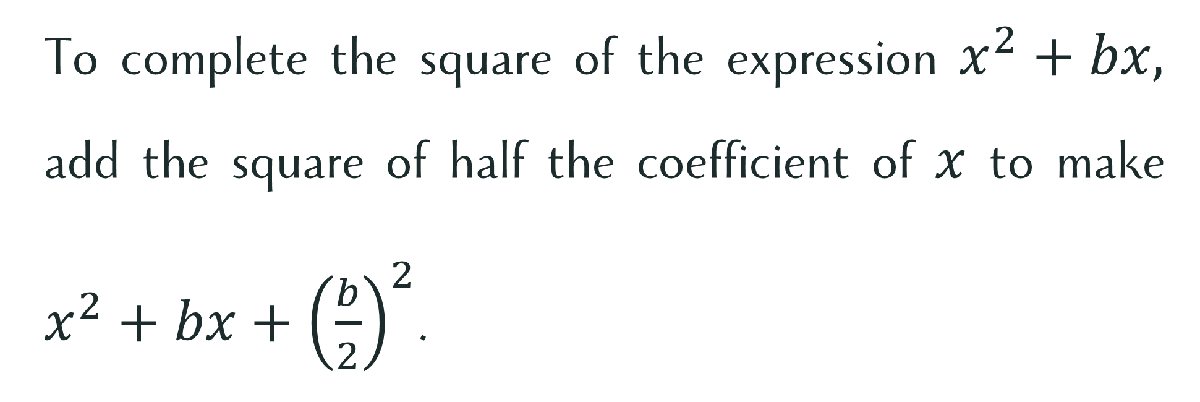
Completing the Square
To complete the square of the expression $x^{2}+bx,$ add the square of half the coefficient of $x$ to make $x^{2}+bx+{\left(\frac{b}{2}\right)}^{2}$.

Slide 11
Let’s try this!

Slide 12

Complete the square
$$x^{2}+4x$$

Slide 13
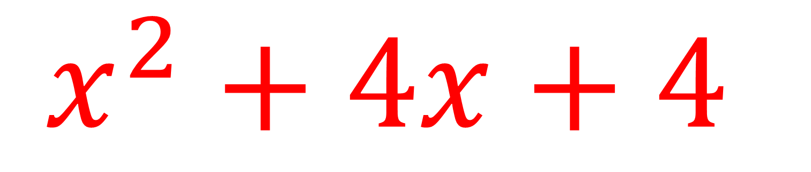

Complete the square
$$x^{2}+4x$$
$$x^{2}+4x+4$$

Slide 14

Complete the square
$$x^{2}+14x$$

Slide 15
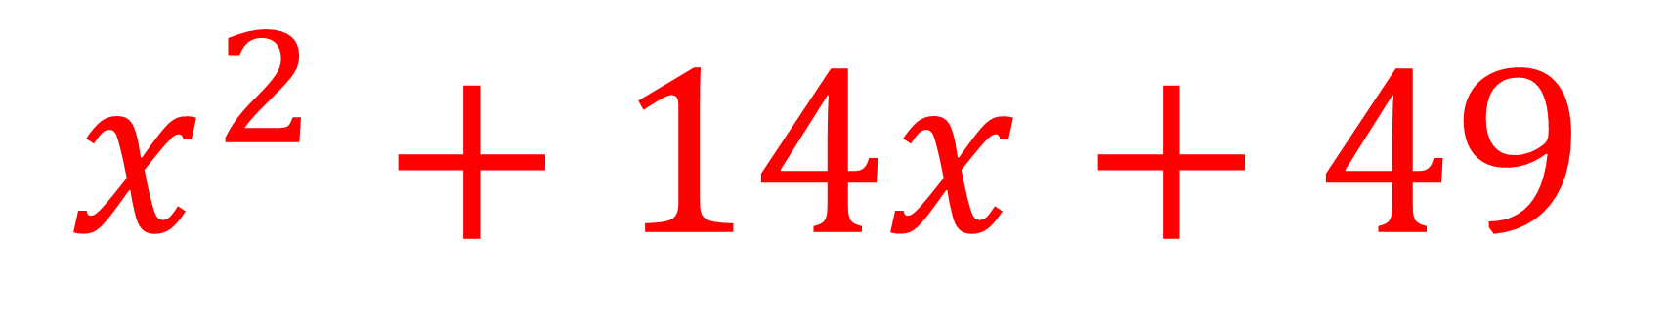
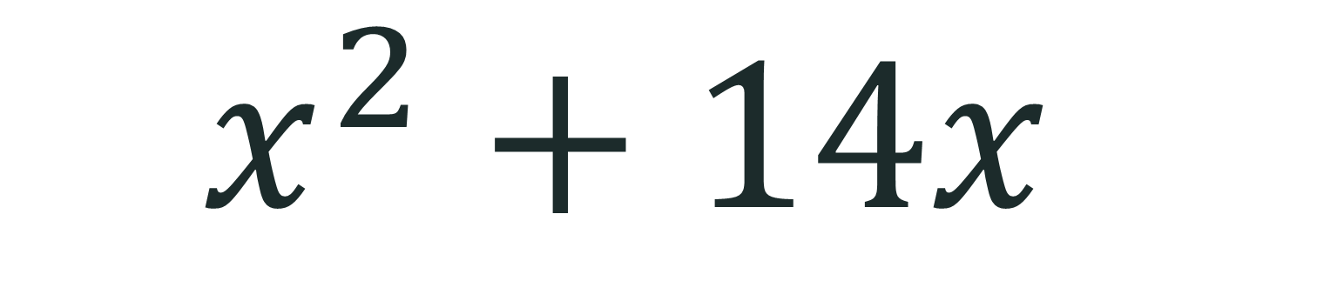
Complete the square
$$x^{2}+14x$$
$$x^{2}+14x+49$$

Slide 16

Complete the square
$$x^{2}+3x$$

Slide 17
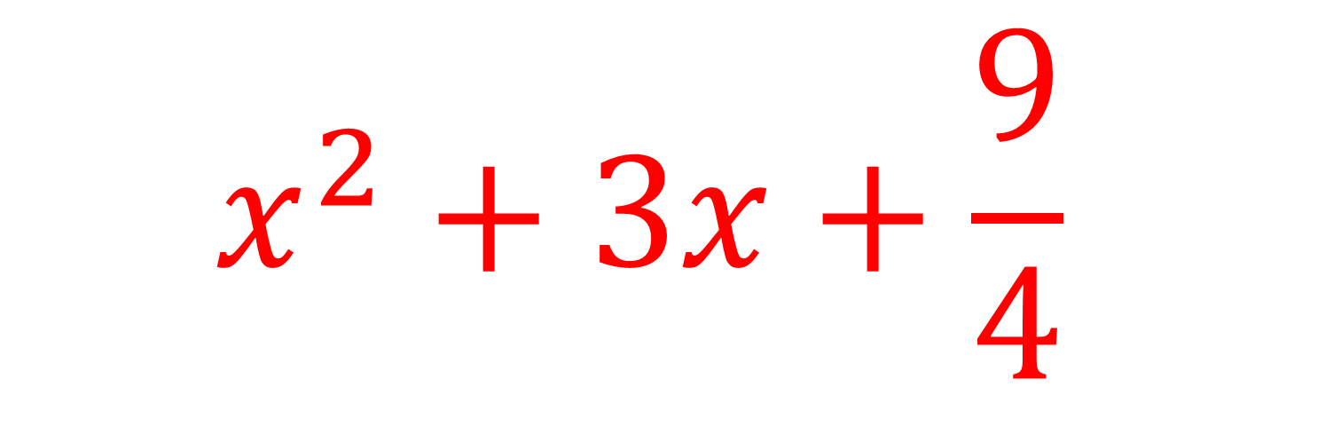

Complete the square
$$x^{2}+3x$$
$$x^{2}+3x+\frac{9}{4}$$

Slide 18

Steps in Completing the Square
Step 1. Write the terms with variables on one side of the equation.
Step 2. Arrange the terms in descending order.
Step 3. If the coefficient of $x^{2}$is not $1$, divide both sides by the coefficient.
Step 4. Add ${\left(\frac{b}{2}\right)}^{2}$to both sides of the equation to complete the square.
Step 5. Factor the perfect square trinomial on one side. Simplify the expression on the other side.
Step 6. Take the square roots of both sides and solve for x.

Slide 19
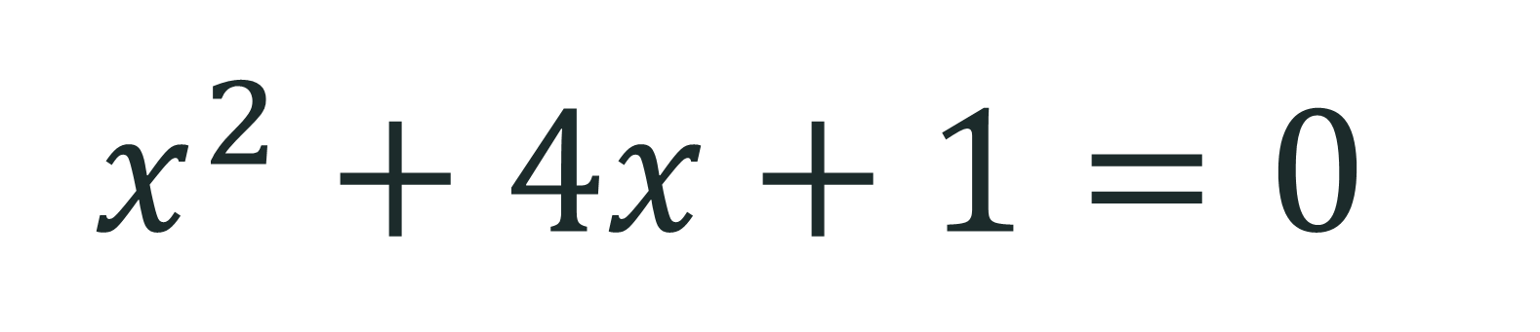
Let’s Try This!
$$x^{2}+4x+1=0$$

Slide 20
Let’s practice!

Slide 21
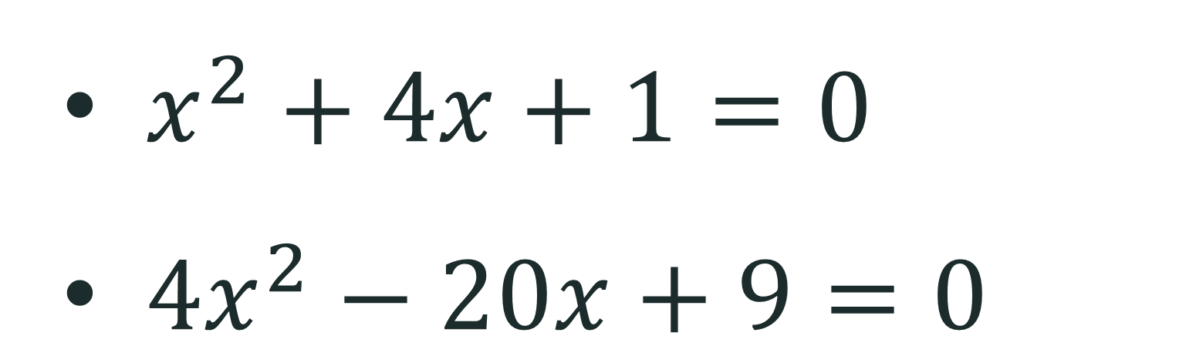
Book Activity
Study the lesson on Completing the Square in your Mathematics textbook (Pages 9–12).
After studying the lesson, answer Mental Math C on Page 17 as your practice exercise.

Slide 22
Exit Pass
Write the answer on your notebook.
How will you compare the completing of square method to the first two methods in solving quadratic equations?

Slide 23


Respect
Just as not every trinomial is a perfect square trinomial, not every person is perfect.
How can we show respect to others despite their mistakes and imperfections?

